Slide 1






HIGH
ECOLOGY

Slide 2

PROJECT
I
MEMBERS
Murillo Castro, Rafael Lopes, Rodrigo Lima, Vinicius Rafael.

Slide 3
PROJECT
I
MEMBERS
Murillo Castro, Rafael Lopes, Rodrigo Lima, Vinicius Rafael.
II
THEME
High Ecology is a project in which we developed a web application for a course platform.

Slide 4
PROJECT
I
MEMBERS
Murillo Castro, Rafael Lopes, Rodrigo Lima, Vinicius Rafael.
II
THEME
High Ecology is a project in which we developed a web application for a course platform.
III
differential
What sets us apart from other platforms is our care and our focus on ecology and environmental awareness in the virtual space.

Slide 5
PROJECT
I
MEMBERS
Murillo Castro, Rafael Lopes, Rodrigo Lima, Vinicius Rafael.
II
THEME
High Ecology is a project in which we developed a web application for a course platform.
III
DIFFERENTIAL
What sets us apart from other platforms is our care and our focus on ecology and environmental awareness in the virtual space.
IV
WHAT IS THE DIAGRAM
The Use Case Diagram is a schematic representation of how a system works.

Slide 6


ACTORS
STUDENT
TEACHER
Our Client
Our Manager

Slide 7
CASES
CUSTOMER REGISTER
It represents that the user is responsible for their registration.
TAKE COURSES
It´s a more practical action for the user, it involves their study actions on the website.
VIEW PLANS
It´s base action, he will be able to see the available course package options.
STUDENT
LOG IN
Login, associated with your actions and purchasing processes.

Slide 8
CASES
maintain courses
Actions related to CRUD, create, read, update and delete.
LOG IN
Login, associated with your actions and prerequisites.
view transactions
Action to view Student payment history.
TEACHER
EDIT DATA
Action to update some student information.

Slide 9
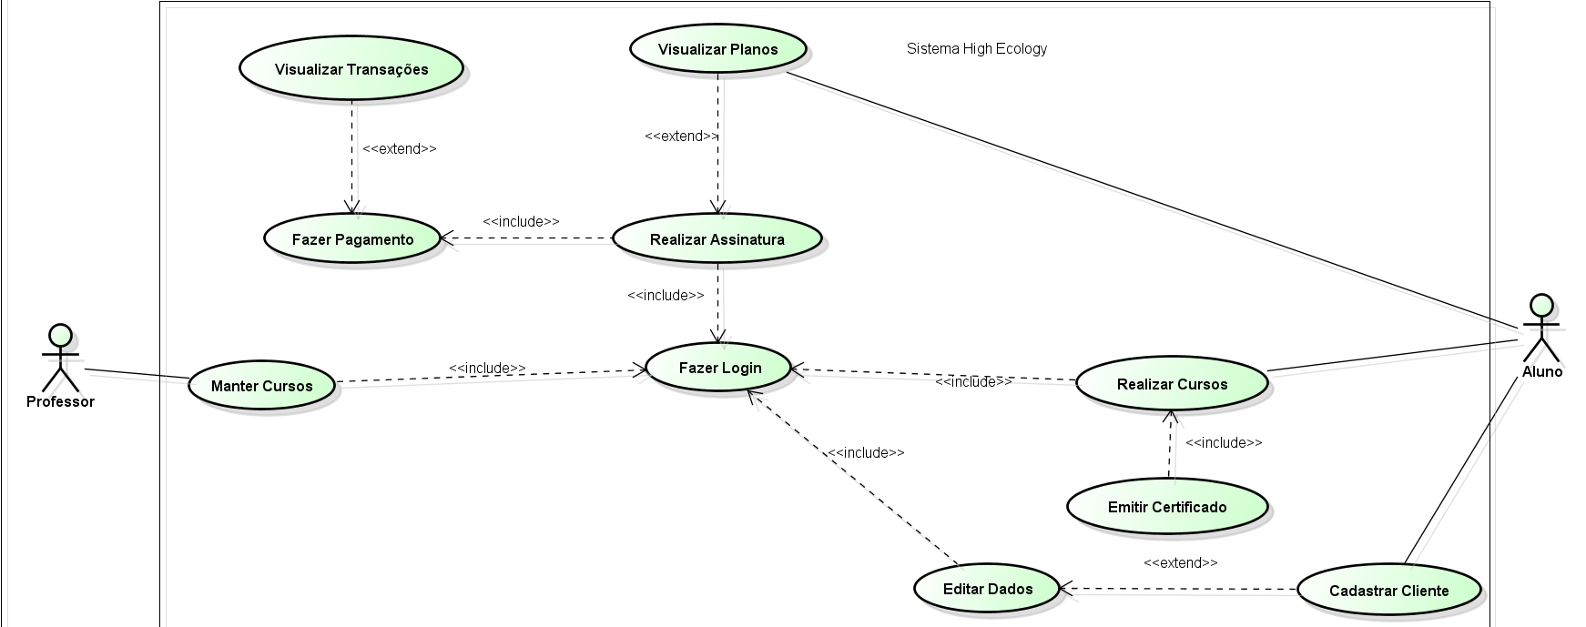
DIAGRAM

Slide 10
DIAGRAM
STUDENT

Slide 11
DIAGRAM
TEACHER

Slide 12
THANK
YOU!
By : Murillo Castro, Rafael Lopes, Rodrigo Lima, Vinicius Rafael

